Slide 1

Fundamentals of
Dotnet and C#

Slide 2

What is Dotnet ?
.NET is a free, open-source platform created by Microsoft that allows developers to build different types of applications, such as web, desktop, mobile, and even games. Think of it as a toolbox full of resources and frameworks that make it easier to write and manage code. With .NET, developers can write code in multiple languages (like C# or F#), and it works across different devices and operating systems, including Windows, Linux, and macOS. Essentially, it simplifies the process of creating software by providing a unified, flexible environment to build applications efficiently.

Slide 3

What all we can create using Dotnet ?
01
Desktop Apps
05
Web Applications
02
Windows Services
06
Web API
03
Console Application
07
Mobile Apps
04
Websites

Slide 4

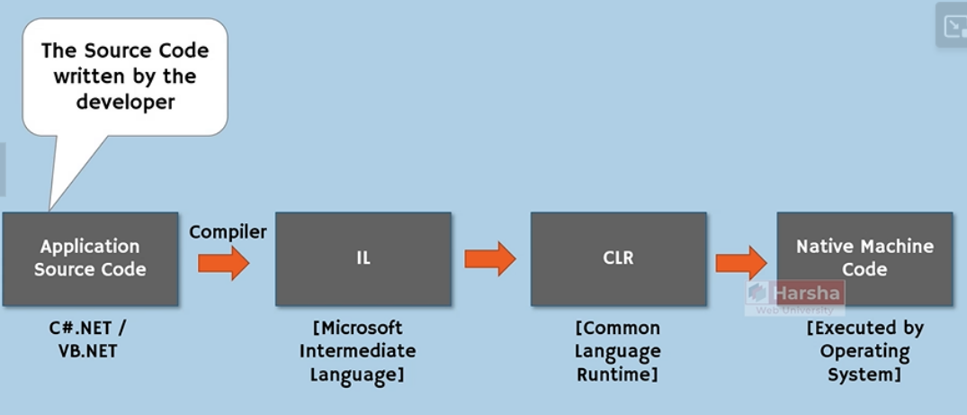
Common Language Infrastructure

Slide 5
First the developer writes the application source code in the form of a programming language eg: C#.
But these application source code which is written in high level languages like C# can’t be understandable by the hardware directly.
So there is a necessity of converting the application source code from C# into native machine code.
The conversion to native machine code will happen in two steps.
In the first step we will convert the application source code into intermediate language which is also called IL.
The IL is mainly introduced to avoid the language specifics that means either C# or VB .NET and there is no separate execution environment for C# or VB .NET and.

Slide 6
IL is not a native machine language ( cannot be executed by machine directly).
So we require the execution engine called CLR (Common Language Runtime) which is the execution engine for all .NET programs.
CLR not only converts the IL into native machine code but also provides several run time services such as thread management, exception management, class loading, garbage collection etc.
So once the CLR converts the IL into native machine code then the native machine code will be executed by the machine hardware.

Slide 7
Common Language Runtime
CLR stands for Common Language Runtime and it is the most important component in .NET.
CLR is the execution engine of .NET programs.
CLR is common for all types of .NET applications which includes desktop, web applications.
It not only converts the IL Language into native machine code but also provides several run time services related to memory management, garbage collection , exception management , thread management etc.

Slide 8



Common Language Runtime
In order to accomplish all these responsibilities , the CLR has several sub components such as
Class Loader
Memory Manager
Garbage Collector
JIT Compiler
Exception Manager
Thread Manager
Security Manager

Slide 9
.NET Framework vs .NET
.NET Core (.NET) is cross platform (Windows,Linux,MacOs)
But .NET Framework only supports Windows.
.NET is free to use,modify and distribute (open source) but .NET Framework is not.
.NET has built-in dependency injection but .NET Framework doesn't.

Slide 10

Let’s learn about C#
C# is a general purpose programming language
by Microsoft
introduced in 2002, C# is an object oriented programming
language and contains a collection of classes.
It provides strong memory management, exception handling, and type safety,
making it an ideal choice for building both large-scale enterprise applications and smaller projects.

Slide 11
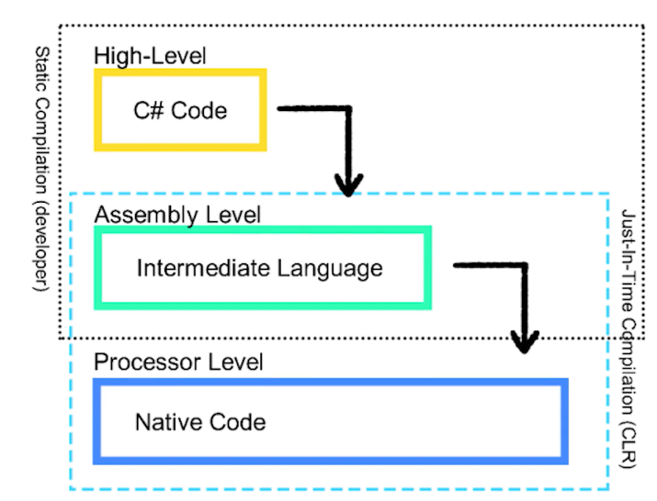

Slide 12

Let’s do some
actual coding !!!

